Slide 1
Managerial Control
Chapter 16
McGraw-Hill/Irwin
Copyright © 2011 by the McGraw-Hill Companies, Inc. All rights reserved.

Slide 2
Learning Objectives
LO 1 Explain why companies develop control systems for employees.
LO 2 Summarize how to design a basic bureaucratic control system.
LO 3 Describe the purposes for using budgets as a control device.
LO 4 Define basic types of financial statements and financial ratios used as controls.
LO 5 List procedures for implementing effective control systems.
LO 6 Identify ways in which organizations use market control mechanisms.
LO 7 Discuss the use of clan control in an empowered organization.
16-<number>

Slide 3


Managerial Control
Control
  Any process that directs the activities of individuals toward the achievement of organizational goals
16-<number>

Slide 4
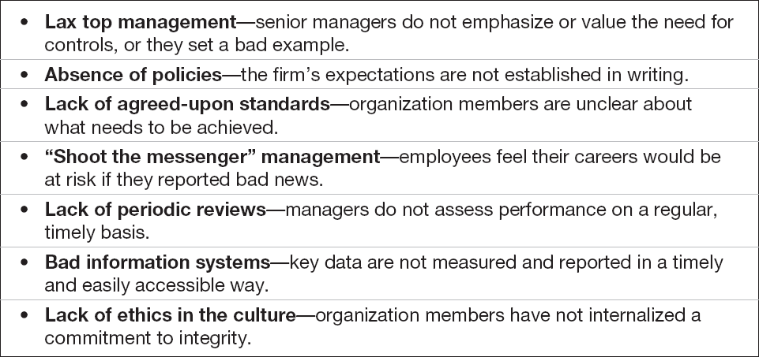
Symptoms of an Out-of-Control Company
Table 16.1
16-<number>

Slide 5
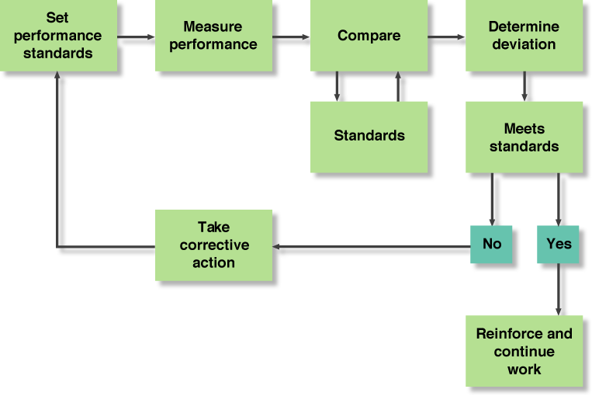
The Control Process
Figure 16.1
16-<number>

Slide 6
Bureaucratic Control Systems
Bureaucratic control
  The use of rules, regulations, and authority to guide performance
Market control
  Control based on the use of pricing mechanisms and economic information to regulate activities within organizations
16-<number>

Slide 7

Bureaucratic Control Systems
Clan control
  Control based on the norms, values, shared goals, and trust among group members.
16-<number>

Slide 8
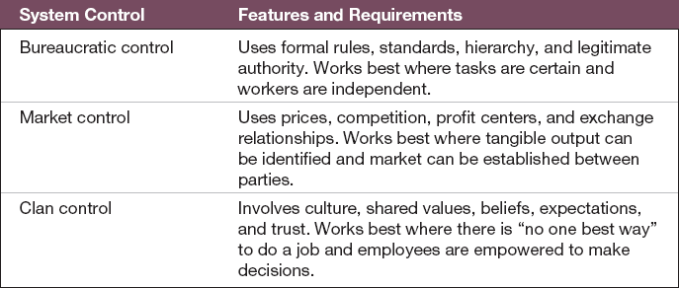
Characteristics of Control
Table 16.2
16-<number>

Slide 9
The Control Cycle
Setting performance standards.
Measuring performance.
Comparing performance against the standards and determining deviations.
Taking action to correct problems and reinforce successes.
16-<number>

Slide 10
Setting Performance Standards
Standard
  Expected performance for a given goal: a target that establishes a desired performance level, motivates performance, and serves as a benchmark against which actual performance is assessed.
16-<number>

Slide 11
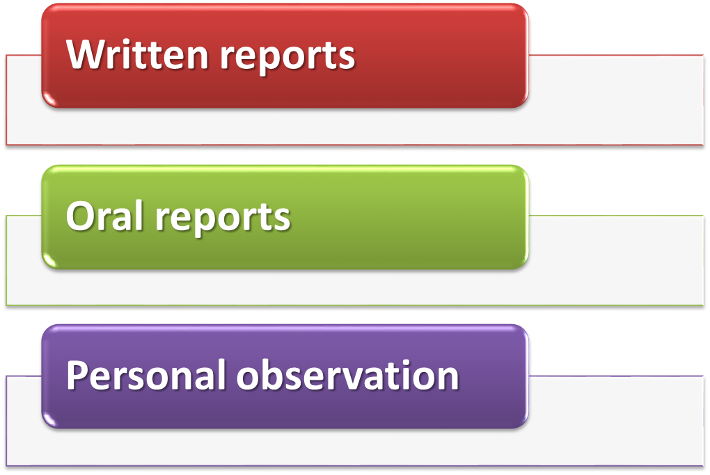
Measuring Performance
16-<number>

Slide 12
Comparing Performance with the Standard
Principle of exception
  A managerial principle stating that control is enhanced by concentrating on the exceptions to or significant deviations from the expected result or standard.
16-<number>

Slide 13
Approaches to Bureaucratic Control
Feedforward control
  The control process used before operations begin, including policies, procedures, and rules designed to ensure that planned activities are carried out properly.
16-<number>

Slide 14

Approaches to Bureaucratic Control
Concurrent control
  The control process used while plans are being carried out, including directing, monitoring, and fine-tuning activities as they are performed.
16-<number>

Slide 15
Approaches to Bureaucratic Control
Feedback control
  Control that focuses on the use of information about previous results to correct deviations from the acceptable standard.
16-<number>

Slide 16

The Role of Six Sigma
One of the most important quality control tools to emerge is six sigma,
At a six-sigma level, a process is producing fewer than 3.4 defects per million, which means it is operating at a 99.99966 percent level of accuracy
Six Sigma companies have not only close to zero product or service defects but also substantially lower production costs and cycle times and much higher levels of customer satisfaction
16-<number>

Slide 17
Question
  ___________ is an evaluation of the effectiveness and efficiency of various systems within an organization.
  External audit
  Internal audit
  Management audit
  HR Audit
16-<number>
Notes:
The correct answer is c – management audit. See next slide.

Slide 18

Management Audits
Management audit
  An evaluation of the effectiveness and efficiency of various systems within an organization
16-<number>

Slide 19
Management Audits
External audit
  An evaluation conducted by one organization, such as a CPA firm, on another.
Internal audit
  A periodic assessment of a company’s own planning, organizing, leading, and controlling processes.
16-<number>

Slide 20
External Audit
Investigates other organizations for possible merger or acquisition
Determines the soundness of a company that will be used as a major supplier
Discovers the strengths and weaknesses of a competitor to maintain or better exploit the competitive advantage of the investigating organization
16-<number>

Slide 21
Internal Audit
Assesses what the company has done for itself
What it has done for its customers or other recipients of its goods or services.
16-<number>

Slide 22
Budgetary Controls
Budgeting
  The process of investigating what is being done and comparing the results with the corresponding budget data to verify accomplishments or remedy differences
  also called budgetary controlling.
16-<number>

Slide 23
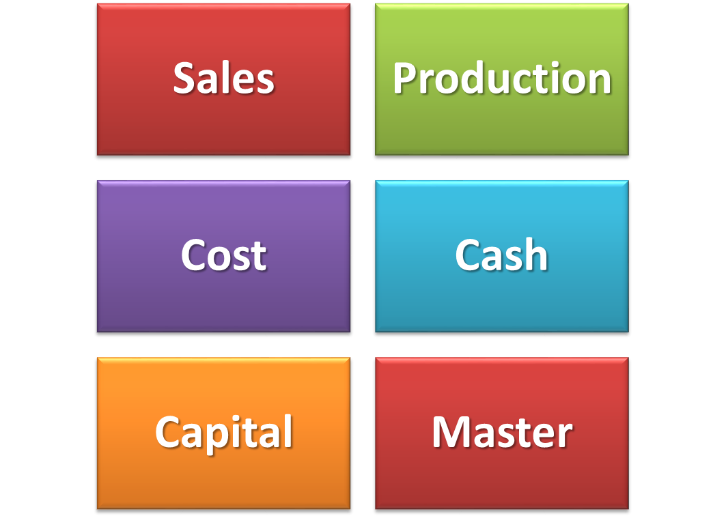
Types of Budgets
16-<number>

Slide 24

Types of Budgets
Accounting audits
  Procedures used to verify accounting reports and statements.
16-<number>

Slide 25
Activity-Based Costing
Activity-based costing (ABC)
  A method of cost accounting designed to identify streams of activity and then to allocate costs across particular business processes according to the amount of time employees devote to particular activities
16-<number>

Slide 26
Financial Controls
Balance sheet
  A report that shows the financial picture of a company at a given time and itemizes assets, liabilities, and stockholders’ equity.
16-<number>

Slide 27
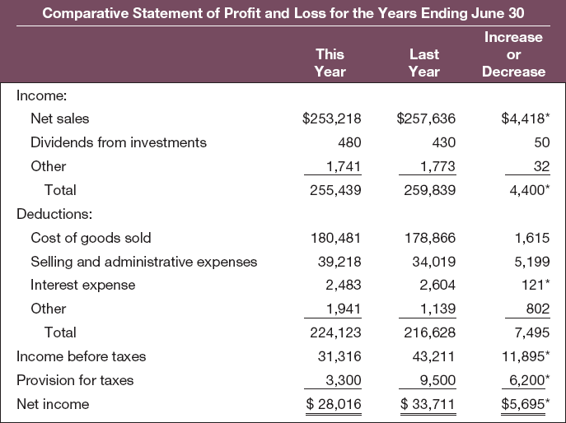
The Profit and Loss Statement
Profit and loss statement
  An itemized financial statement of the income and expenses of a company’s operations
Table 16.6
16-<number>

Slide 28
Financial Controls
Assets
  The values of the various items the corporation owns.
Liabilities
  The amounts a corporation owes to various creditors
Stockholders’ equity
  The amount accruing to the corporation’s owners.
Assets = Liabilities + Stockholders’ equity
16-<number>

Slide 29
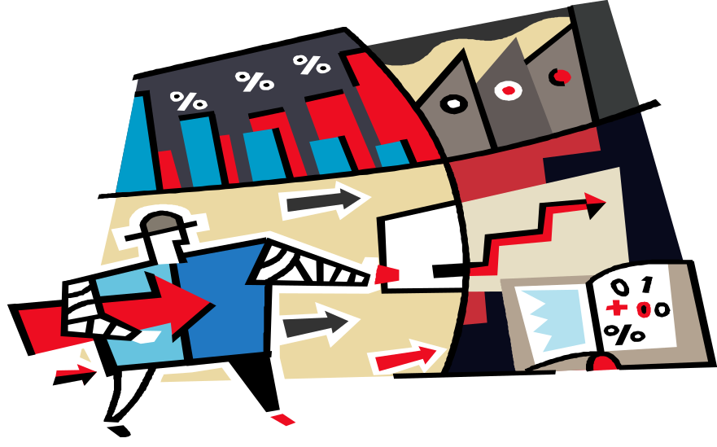
Financial Ratios
Current ratio
  A liquidity ratio that indicates the extent to which short term assets can decline and still be adequate to pay short-term liabilities
16-<number>

Slide 30
Financial Ratios
Debt-equity ratio
  A leverage ratio that indicates the company’s ability to meet its long-term financial obligations
Return on investment (ROI)
  A ratio of profit to capital used, or a rate of return from capital
16-<number>

Slide 31
Question
  ___________ is focusing on short-term earnings and profits at the expense of longer-term strategic obligations.
  Management amblyopia
  Personnel myopia
  Management myopia
  Short-sighted angst
16-<number>
Notes:
The correct answer is c – management myopia. See next slide.

Slide 32

Using Financial Ratios
Management myopia
  Focusing on short-term earnings and profits at the expense of longer-term strategic obligations.
16-<number>

Slide 33
Designing Effective Control Systems
Establish valid performance standards.
Provide adequate information to employees.
Ensure acceptability to employees.
Maintain open communication.
Use multiple approaches.
16-<number>

Slide 34
Balanced Scorecard
Balanced scorecard
  Control system combining four sets of performance measures: financial, customer, business process, and learning and growth
16-<number>

Slide 35
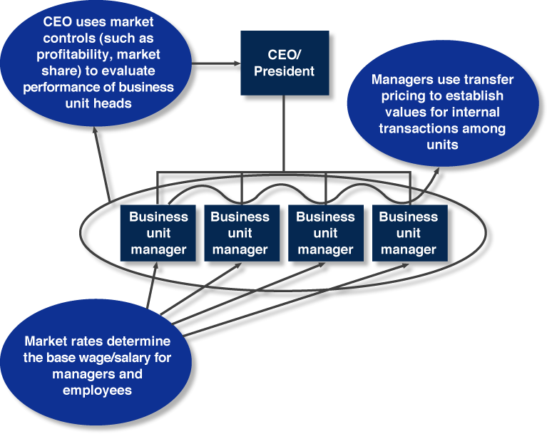
Examples of Market Control
Figure 16.3
16-<number>

Slide 36
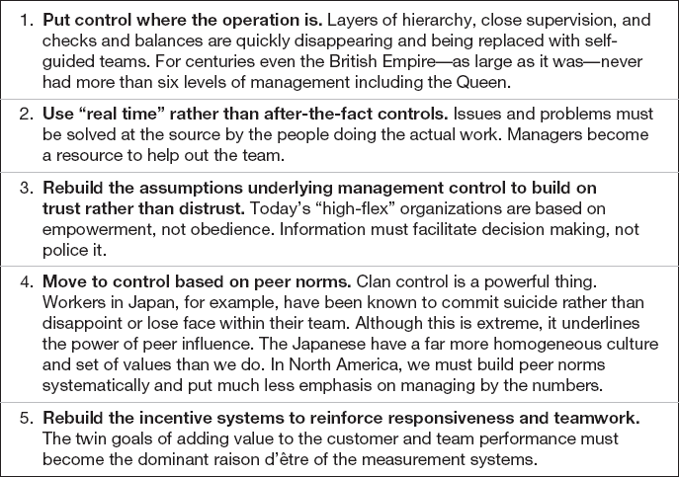
Management Control in an
Empowered Setting
Table 16.7
16-<number>

